Slide 1
Re-ranking the ResNet-based Large Human Face Feature Extractor by Approximate Nearest Neighbor
Presenter: Sheng-Hsing Hsiao
Advisor: Jyh-Shing Roger Jang
Dept. of CSIE, National Taiwan University, Taiwan
Notes:
Ｌ

Slide 2
Outline
Introduction
Related Work
Methods
Experiments
Conclusions
References

Slide 3
Introduction
Three steps: 1) face detection, 2) face alignment, 3) face feature encoding
A comparison two different face detectors, MTCNN and FaceBoxes
Evaluate the performance of face feature extractors
Notes:
不要寫全部 放片語

Slide 4
Related Work
https://arxiv.org/pdf/1811.09998.pdf

Slide 5
Related Work
https://arxiv.org/pdf/1711.10703.pdf

Slide 6
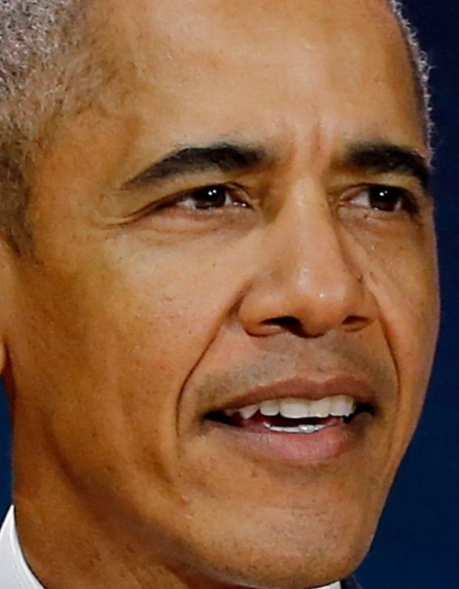
Method
System flowchart
Input image
Face
Detection
Face verification
Face
recognition
Measure similarity
Face
Alignment
Face Feature Extractor
The most similar
Aligned face
Face representations
Below the
threshold
Barack Obama
Intruder
Notes:
合成一張

Slide 7
Method
Face detection
Faceboxes: A CPU real-time face detector with high accuracy
https://arxiv.org/pdf/1708.05234
Notes:
Rapidly Digested Convolutional Layers 主要是解決速度問題
快速的縮小feature map的大小
採用C.ReLU activation function
使用CRelU來保證輸出維度不變的情況下，減少卷積核數量
Multiple Scale Convolutional Layers(MSCL)
類似於SSD，在網絡的不同層進行檢測
作者提出來的點就在於增加小的anchor的訓練
定義了anchor 密度 來平衡對密度不足的anchor來增加偏移訓練

Slide 8
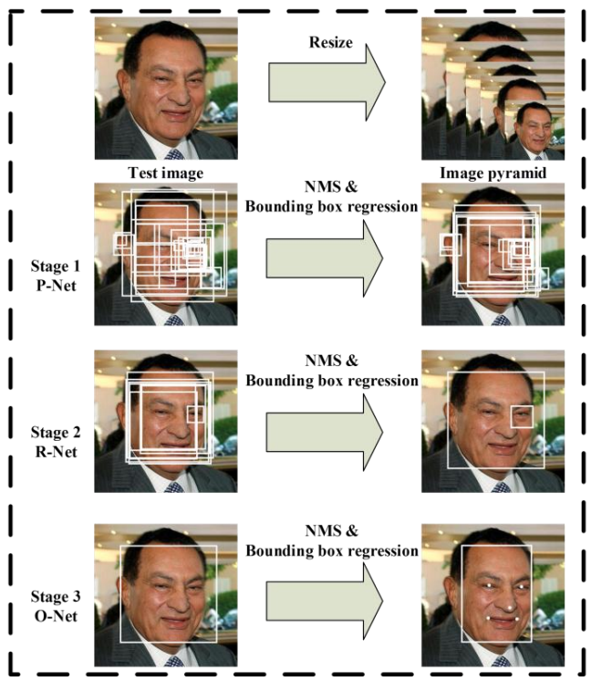
Method
MTCNN: Joint Face Detection and Alignment using Multi-task Cascaded Convolutional Networks
https://arxiv.org/abs/1604.02878
Notes:
在2016年提出的一個multi-task 論文的人臉偵測還有人臉特徵同時進行
給定一張照片的時候，將其縮放到不同尺度形成圖像金字塔，以達到尺度不變
總共有三個CNN cascade
3個stage對人臉的處理是按照一種由粗到細的方式
pnet是一個全卷積網絡(FCN)，全卷積網絡的優點在於可以輸入任意尺寸的圖像，生成人臉分類、一些bounding box、還有人臉上的landmark
使用Bounding box regression的方法來校正這些候選窗
使用非極大值抑制（NMS）合併重疊的候選框

Slide 9
Method
VGGface

Slide 10
Experiments
Experimental settings
OS: Ubuntu 16.04
CPU: Intel(R) Xeon(R) E5-2630 10 cores @ 2.20GHz
GPU: GeForce GTX 1080 Ti
Memory: 128GB
Code language: Python 3.6.7
Notes:
加上core

Slide 11
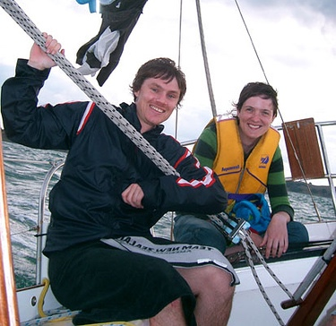
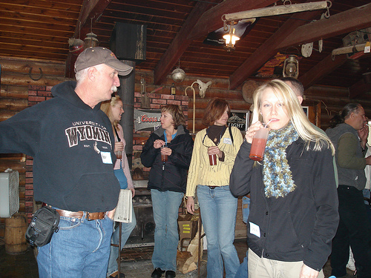
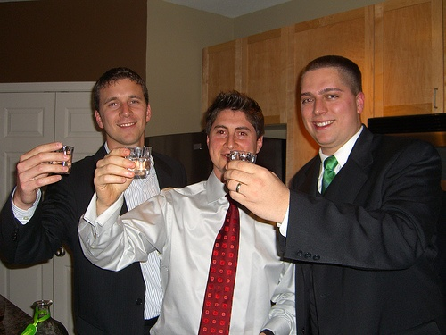
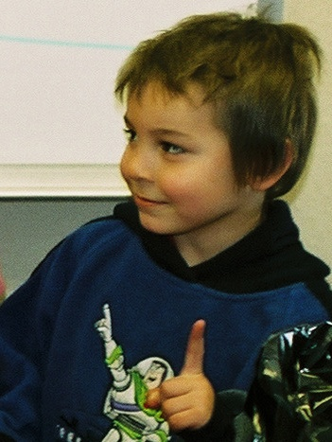
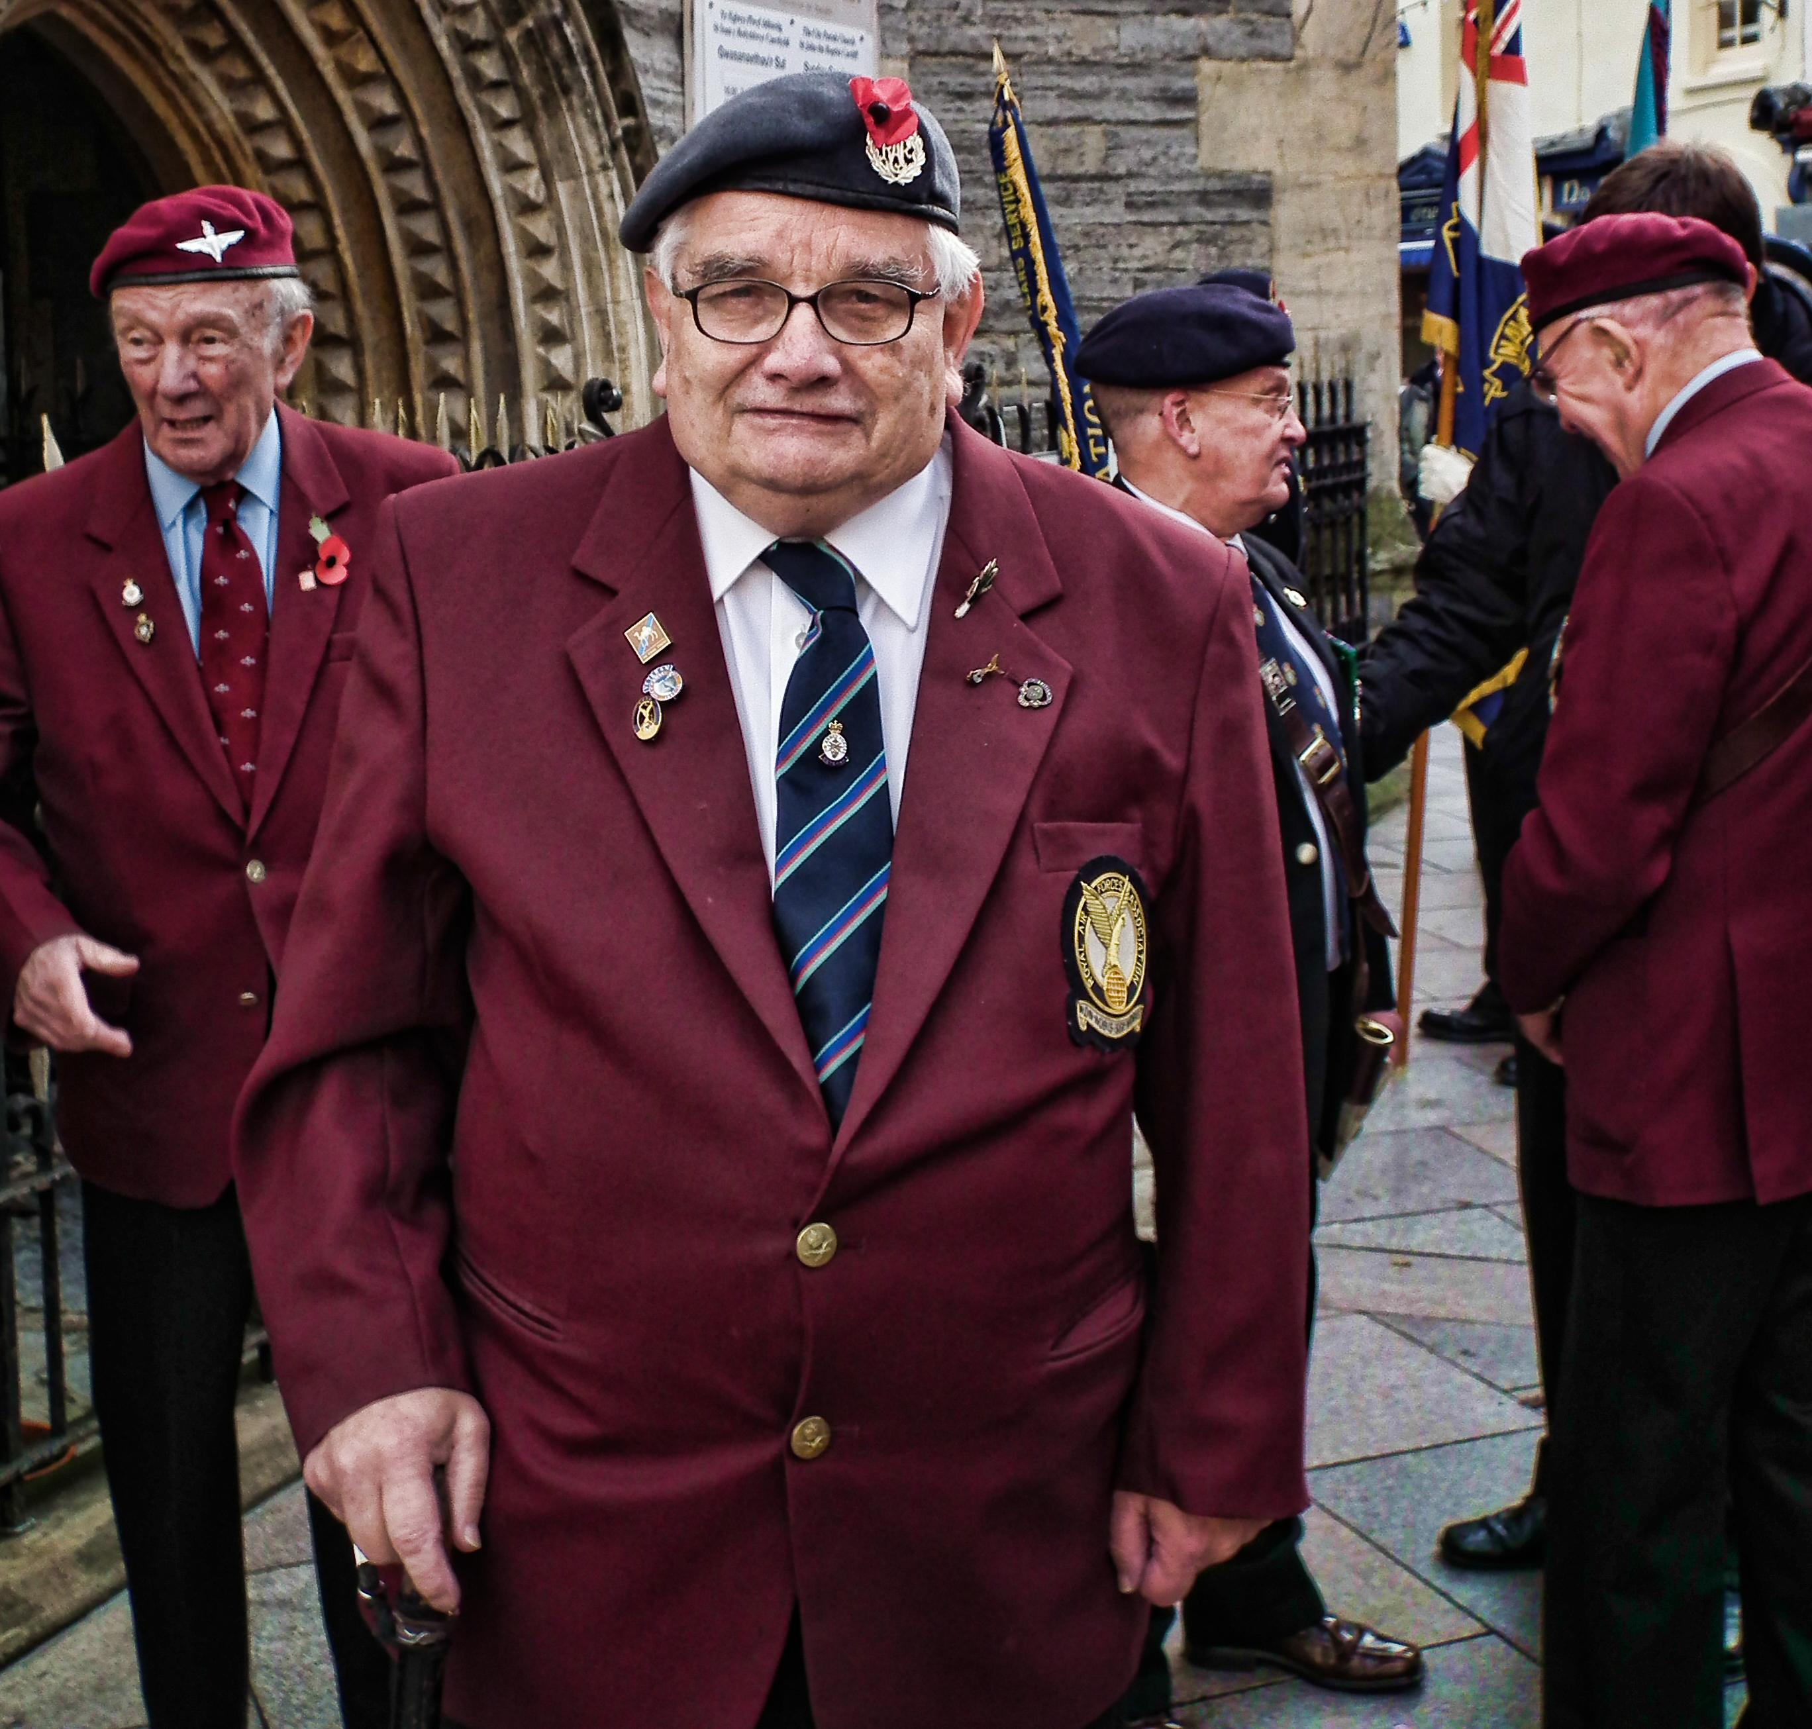
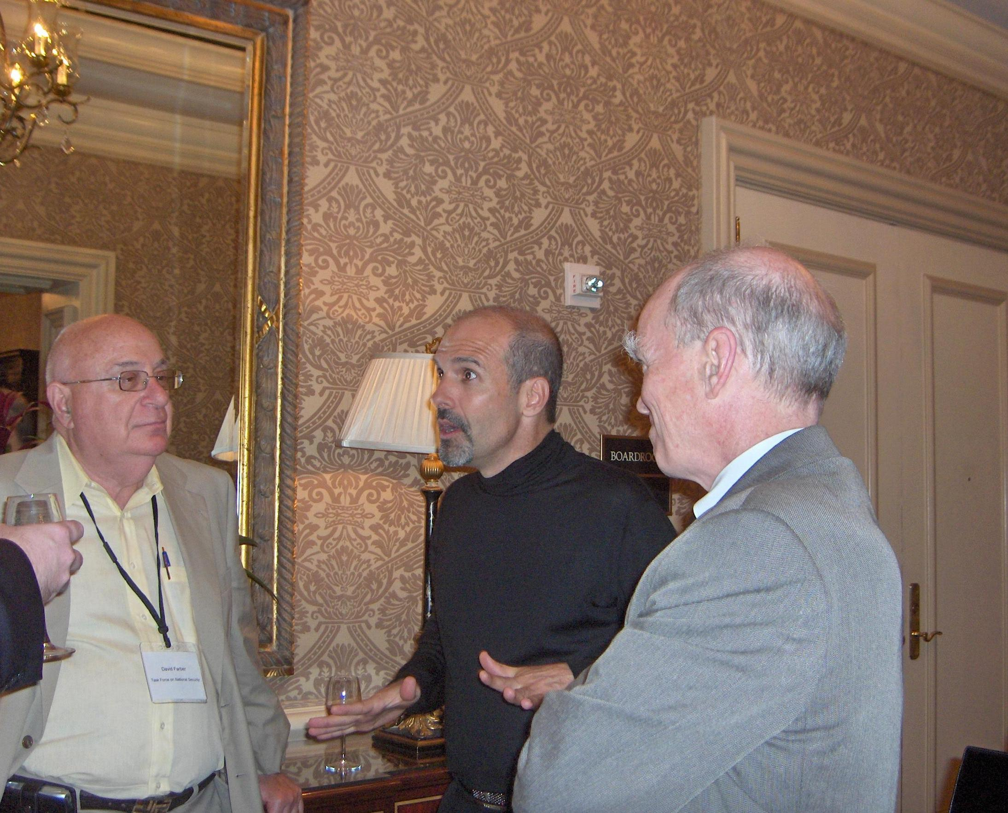
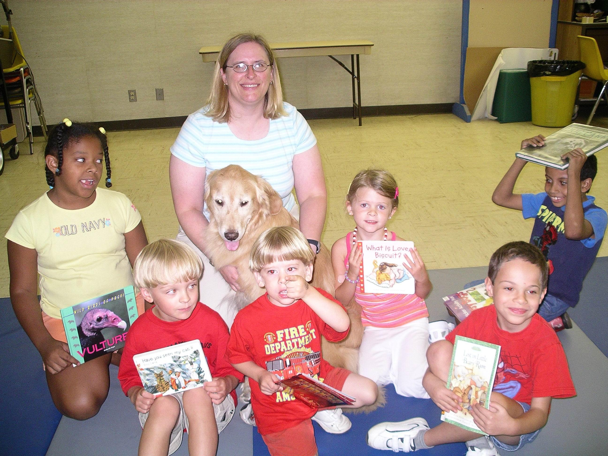
Experiments of Face Detection
Performance of face detection
Datasets
PASCAL face
1335 faces from 851 images
Some examples:
AFW
205 images with 473 labeled faces
Some examples
Notes:
PASCAL person layout dataset
Annotated Faces in the Wild

Slide 12
Experiments of Face Detection (cont.)
Performance of face detection
Datasets
FDDB
5,171 faces in 2,845 images
Evaluate on discrete ROC curves
Provide bounding ellipse
Data-preprocessing: convert the ellipses to minimum bounding rectangles
bounding ellipse
Notes:
Face Detection Data Set and Benchmark
離散的意思是一個face一個face看

Slide 13
Experiments of Face Detection (cont.)
Performance of face detection runtime
Dataset
UTKFace
Large-scale face dataset and only single face in one image
23,709 facial images
https://susanqq.github.io/UTKFace/

Slide 14
Experiments of Face Detection (cont.)
Performance of face detection
Intersection over Union (IOU)
An Intersection over Union score > 0.5 is normally considered a “good” prediction. Depending on the metric, threshold usually be set to 50%, 75% or 95%.
True Positive (TP): A correct detection. Detection with IOU ≥ threshold
False Positive (FP): A wrong detection. Detection with IOU < threshold
False Negative (FN): A ground truth not detected
True Negative (TN): Does not apply.

Slide 15
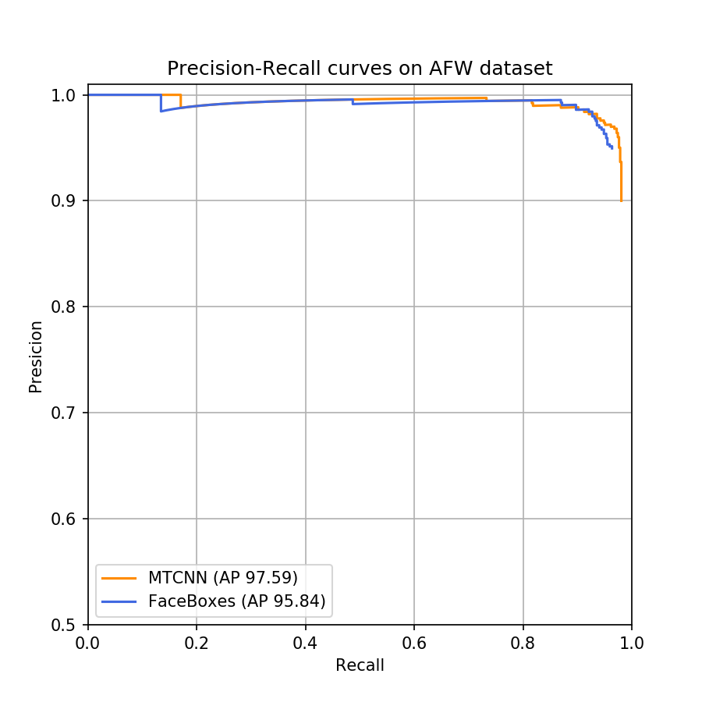
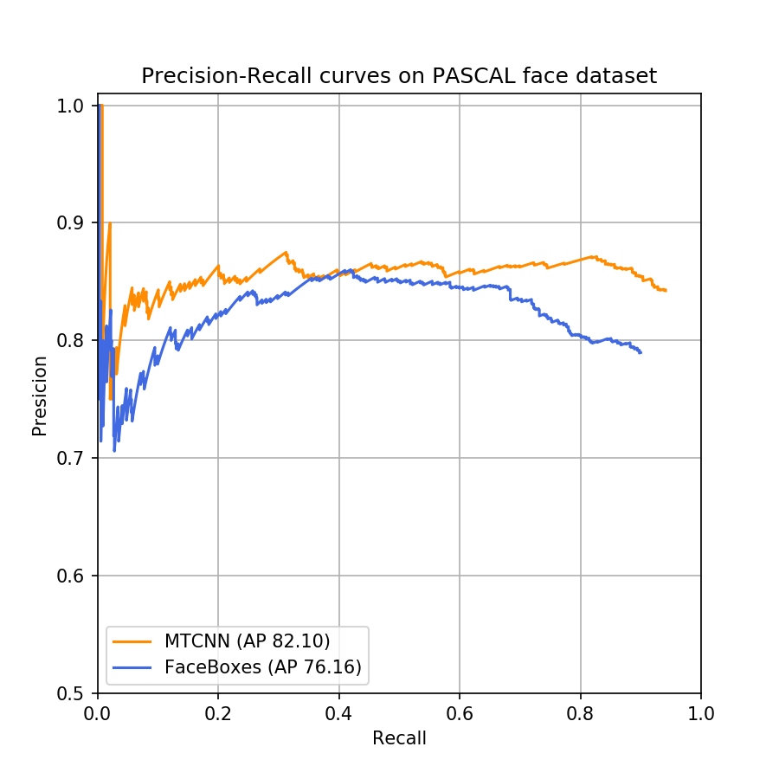
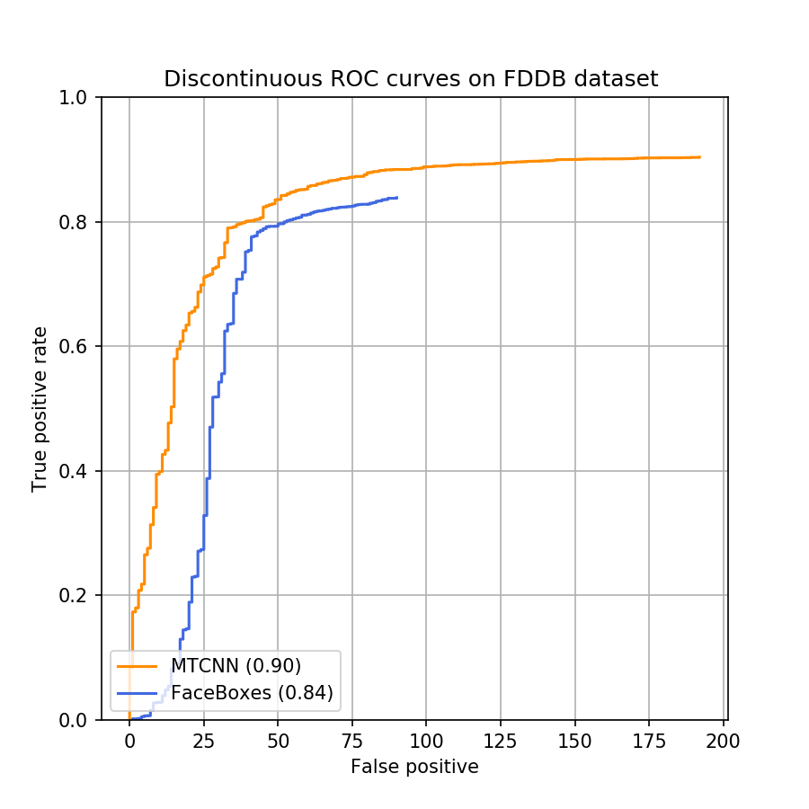
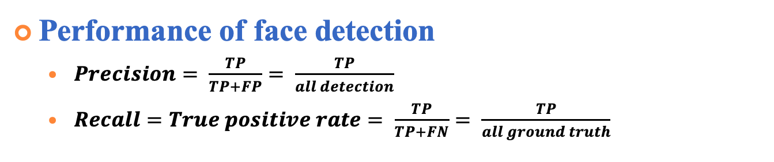
Experiments of Face Detection (cont.)
Performance of face detection
$Precision= \frac{TP}{TP+FP}= \frac{TP}{all detection}$
$Recall=True positive rate= \frac{TP}{TP+FN}= \frac{TP}{all ground truth}$
AFW dataset
PASCAL face dataset
FDDB dataset
Notes:
Average precision 就是曲線下的面積
ＦＤＤＢ他有自己的評估方式類似roc的方式，橫軸是false positive

Slide 16
Experiments of Face Detection (cont.)
Performance of face detection runtime efficiency
Dataset
UTKFace
Approach | mAP(%) | FPS (On GPU) | FPS (On CPU)
MTCNN | 94.4% | 8.86 | 6.25
FaceBoxes | 89.3% | 42.91 | 20.07

Slide 17
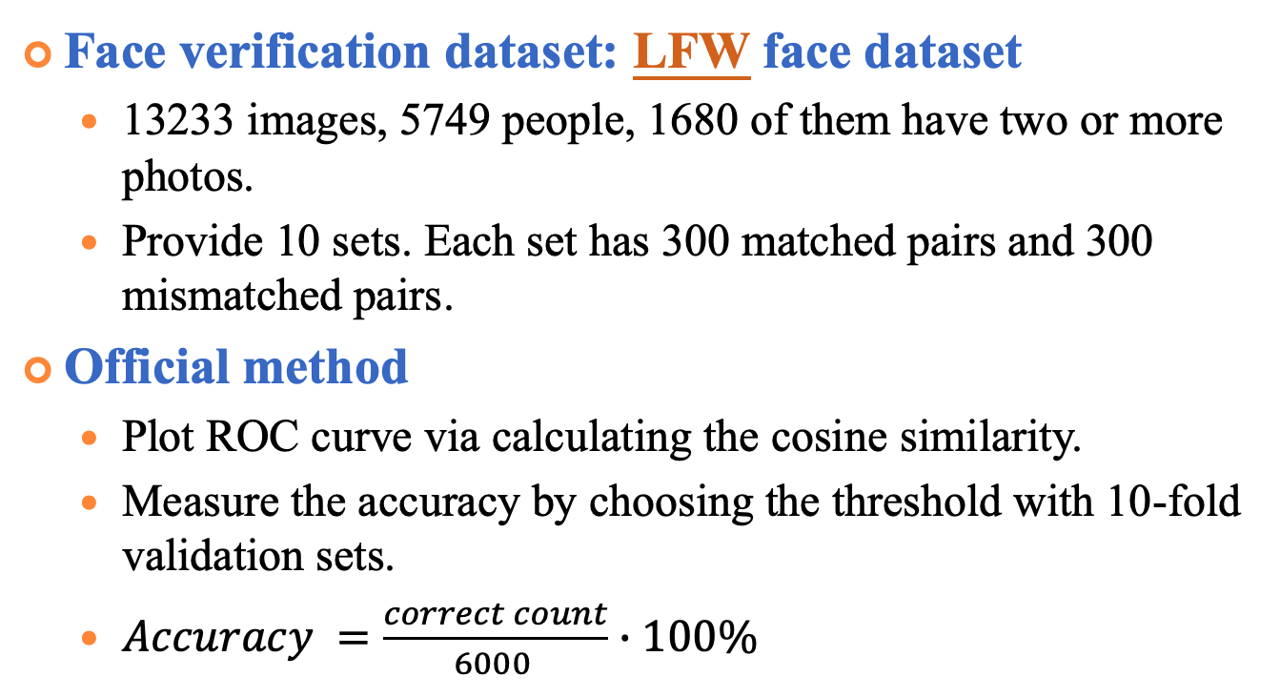
Experiments of Face Verification
Face verification dataset: LFW face dataset
13233 images, 5749 people, 1680 of them have two or more photos.
Provide 10 sets. Each set has 300 matched pairs and 300 mismatched pairs.
Official method
Plot ROC curve via calculating the cosine similarity.
Measure the accuracy by choosing the threshold with 10-fold validation sets.
$Accuracy =\frac{correct count}{6000 }∙100\%$
match
pairs
mismatch
pairs
http://vis-www.cs.umass.edu/lfw/
Notes:
Labeled Faces in the Wild ver/rec
http://vis-www.cs.umass.edu/lfw/index.html

Slide 18
Experiments of Face Verification (cont.)
Performance evaluation on LFW
Face verification result
 | Accuracy (%) | Time (s)
VGG16 | 95.33% | 1299
Resnet50 | 99.18% | 1391
Notes:
有 10 fold 每個fold都有自己的fpr/tpr 曲平均可以畫出平均的roc curve
10 個Auc的標準差代表一個標準差是0.001
標準差 根據fold/acc
設定一段threshold的區間，透過10fold算各自錯幾個，選擇平均錯最少的當作threshold 接著再用此threshold當作標準算10fold各自的accuracy平均 小標題要寫ver/rec
performance of face verification 時間 改acc就好1不用mean

Slide 19
Experiments of Face Verification (cont.)
Authorized users Dataset
CASIA-FaceV5
2,500 color facial images of 500 subject, each has 5 images
For each user, 4 images for building database and 1 image for the test.
All face images are 16 bit color BMP files and the image resolution is 640*480
http://biometrics.idealtest.org/dbDetailForUser.do?id=9
Notes:
http://biometrics.idealtest.org/dbDetailForUser.do?id=9

Slide 20
Experiments of Face Verification (cont.)
Intruders Dataset
Helen dataset
2000 images as the outside test set
If there are multiple faces in the picture, select the one closest the image center as the test face.
http://www.ifp.illinois.edu/~vuongle2/helen/

Slide 21
Experiments of Face Verification (cont.)
Face Verification DET curve
Notes:
TPR = TP / (TP+FN);
FNR = FN /（TP + FN） FPR = FP / (FP + TN);

Slide 22
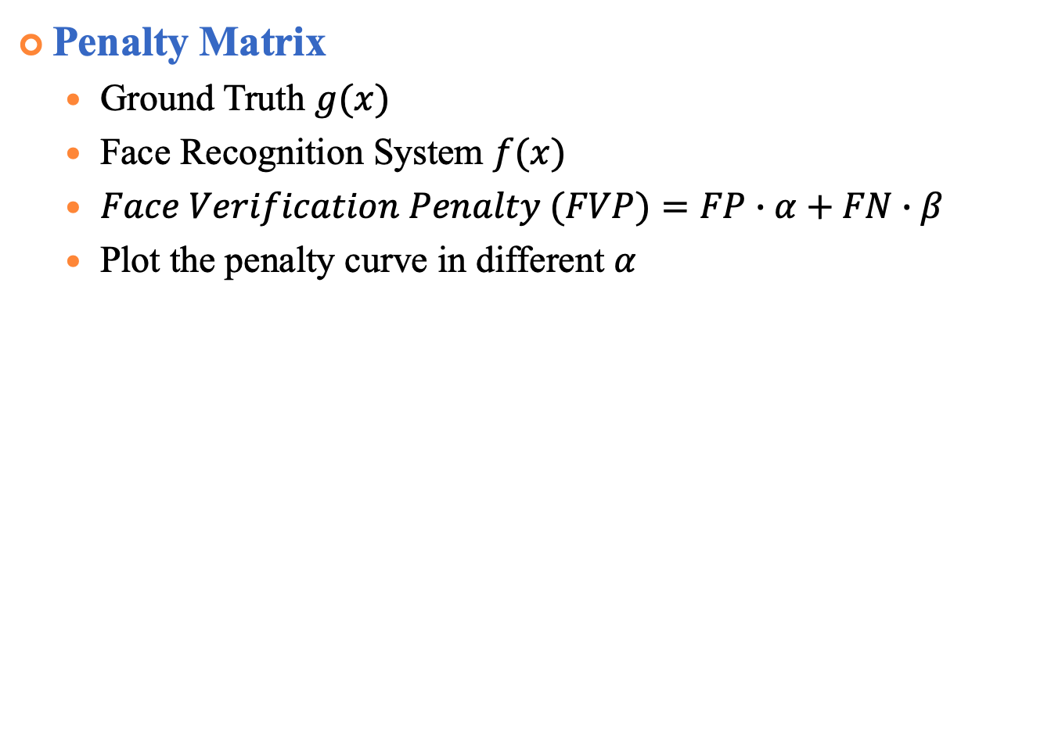
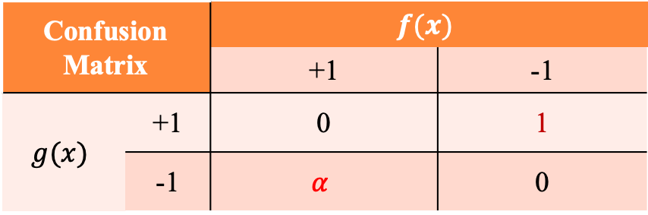
Experiments of Face Verification (cont.)
Penalty Matrix
Ground Truth $g(x)$
Face Recognition System $f(x)$
$Face Verification Penalty (FVP)=FP∙α+FN∙β$
Plot the penalty curve in different $α$
Confusion Matrix |  | $$f(x)$$
 |  | +1 | -1
$$g(x)$$ | +1 | 0 | 1
 | -1 | $$α$$ | 0
Notes:
不用set

Slide 23
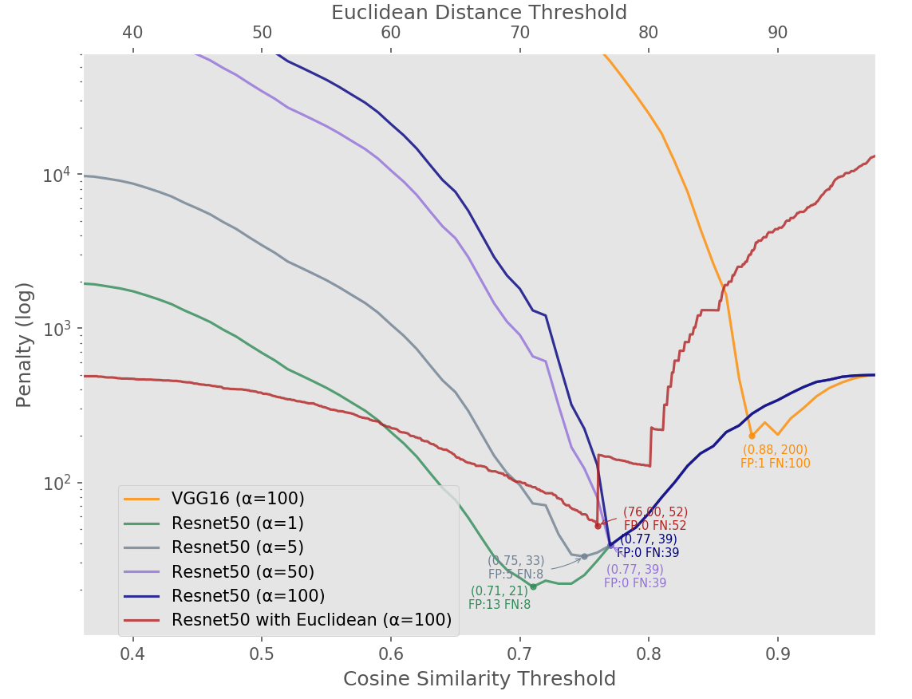
Experiments of Face Verification (cont.)
Face verification penalty curve
Notes:
換顏色 多一個圖fp/fn與alpha的關係

Slide 24
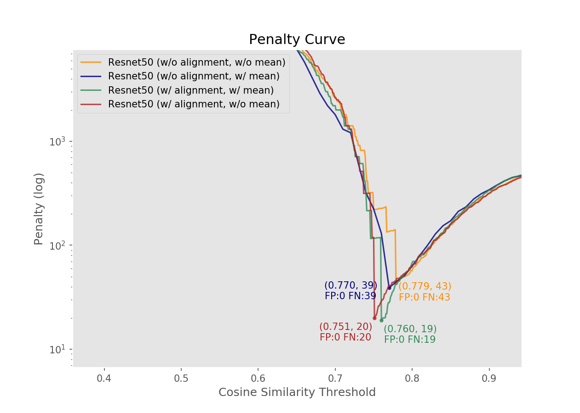
Experiments of Face Verification (cont.)
Compare the effect of alignment
Notes:
有single 與mean其實並沒有差異很多 可以看到有alignment可以減少更多FN 也就是更少人被擋在外面 藍色跟綠色筆 橘色雨紅色筆

Slide 25
Experiments of Face Recognition
Performance of face recognition
No. | Train Align | Test Align | Re-rank | 100%-EER
1 | No | No | No | 98.6
2 | Yes | Yes | No | 98.8
3 | No | Yes | No | 98.8
4 | Yes | Yes | Yes | 99.0
5 | No | Yes | Yes | 99.2
Notes:
correct count 用矩陣表示 多少分支多少 align為啥變差

Slide 26
Experiments of Face Recognition (cont.)
Error images Resnet50 (w/o mean)
(#118_2)
(#419_0)
(#115_3)
(#118_1)
(#320_4)
(#118_4)
(#262_ 0)
(#182_1)
(#295_2)
(#262_2)
(#244_1)
(#262_1)
(#188_3)
(#187_0)
(#188_2)
(#482_0)
(#084_2)
(#471_4)
Notes:
Preprocessing ：subtract channel-wise mean mean channel values of all pictures in dataset.
[91.4953, 103.8827, 131.0912] (in BGR order).

Slide 27
Experiments of Face Recognition (cont.)
Error images Resnet50 (w/o mean, alignment)
(#118_2)
(#419_0)
(#115_3)
(#118_1)
(#118_4)
(#118_3)
(#143_2)
(#258_1)
(#143_4)
(#258_0)
(#436_1)
(#143_0)
(#188_3)
(#187_0)
(#188_2)
(#482_0)
(#188_4)
(#471_4)
Notes:
多加一個投票

Slide 28
Experiments of Face Recognition (cont.)
Error images Resnet50 (w/o mean, test align, re-rank)
(#457_2)
(#312_3)
(#280_2)
(#409_0)
(#457_1)
(#409_2)
(#143_2)
(#258_1)
(#143_4)
(#258_0)
(#436_1)
(#143_0)
(#188_3)
(#187_0)
(#188_2)
(#482_0)
(#188_4)
(#471_4)
Notes:
多家simility 眼鏡可以加在future

Slide 29
Conclusion

Slide 30
Thank you for your attention

Slide 31
Experiments
Super-Resolution
WDSR (Wide Activation for Efficient and Accurate Image Super-Resolution, CVPR Workshop 2018)

Slide 32
Experiments of Face Recognition (cont.)
Error images Resnet50 (w/ mean)
(#251_3)
(#003_4)
Closest (#139)
Similarity: 0.806780
Closest (#157)
Similarity: 0.695130
Second Closest (#251)
Similarity: 0.800584
Second Closest (#003)
Similarity: 0.693844

Slide 33
Experiments of Face Recognition (cont.)
Error images Resnet50 (w/ mean, alignment)
(#244_3)
(#314_2)
Closest (#436)
Similarity: 0.799393
Closest (#020)
Similarity: 0.854172
Second Closest (GT)
Similarity: 0.792944
Second Closest (GT)
Similarity: 0.835937

Slide 34
Experiments
Downscale the high-resolution images

Slide 35
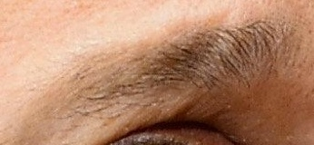
Experiments
Result of the WDSR on VGGFace2
HR
Bicubic X4
WDSR X4
HR

Slide 36
Experiments
Results of Bicubic and Super-resolution
HR
Bicubic4x
Divided4x
SR4x

Slide 37
Experiments
Results of Bicubic and Super-Resolution on LFW

Slide 38
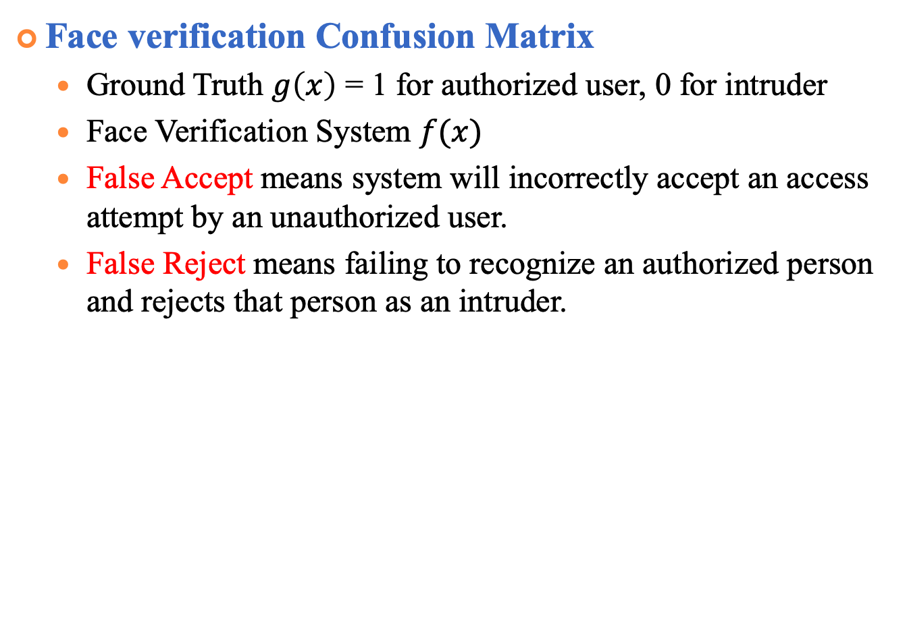
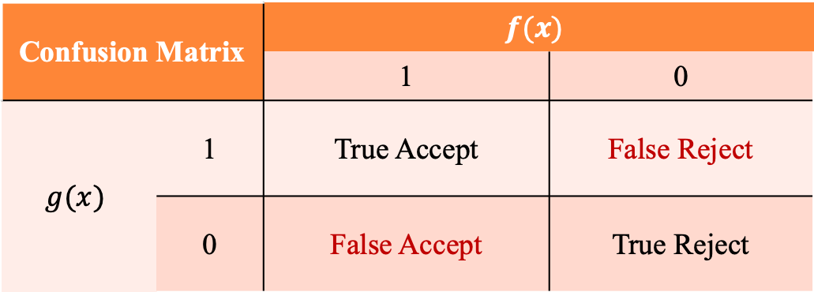
Experiments of face verification (cont.)
Face verification Confusion Matrix
Ground Truth $g\left(x\right)$ = 1 for authorized user, 0 for intruder
Face Verification System $f(x)$
False Accept means system will incorrectly accept an access attempt by an unauthorized user.
False Reject means failing to recognize an authorized person and rejects that person as an intruder.
Confusion Matrix |  | $$f(x)$$
 |  | 1 | 0
$$g(x)$$ | 1 | True Accept | False Reject
 | 0 | False Accept | True Reject
Notes:
http://www.mecs-press.org/ijigsp/ijigsp-v6-n2/IJIGSP-V6-N2-6.pdf 備用投影片

Slide 39
Experiments of Face Verification (cont.)
Siamese Network Architecture
Loss function: Contrastive Loss
Yann LeCun ’06 Dimensionality Reduction by Learning an Invariant Mapping
Notes:
Yann LeCun的Dimensionality Reduction by Learning an Invariant Mapping
D兩個樣本特徵的歐氏距離
y為兩個樣本是否匹配的標籤，y=1代表兩個樣本相似或者匹配，y=0則代表不匹配，alpha為設定的閾值。
主要是用在降維中，即本來相似的樣本，在經過降維（特徵提取）後，在特徵空間中，兩個樣本仍舊相似；而原本不相似的樣本，在經過降維後，在特徵空間中，兩個樣本仍舊不相似。

Slide 40
FDDB samples

